Slide 1
Module I Introduction to Renewable Energy (RE)Sources
World energy scenario
Overview of conventional energy sources, their limitation
Need of renewable energy, potential & development of renewable energy sources
Renewable energy in India
An overview of types of renewable energy systems - Wind power, hydropower (micro and mini), solar energy, biomass, Biofuel, geothermal heat energy, pros and cons, and applications

Slide 2
World energy scenario
To meet energy needs, the world community currently depends heavily on fossil fuels that are nonrenewable and unfriendly to the environment.
More than half of the global energy is used by the industrial sector (54.6%) , followed by the transportation sector with 25.6%, the residential sector with 12.7%, and the commercial sector with 7.1 %.
Energy use is expected to increase worldwide, driven mainly by industry, but this will mostly occur in developing countries with strong economic growth.
Total global energy supply in 2017 was 589 Quad Btu, equivalent to 5.6x 10¹⁷ kJ.
Fossil fuels accounted for 82.7 % ( 27.1 % coal, 33.4 % oil, 22.2 % natural gas) of this total energy production.

Slide 3
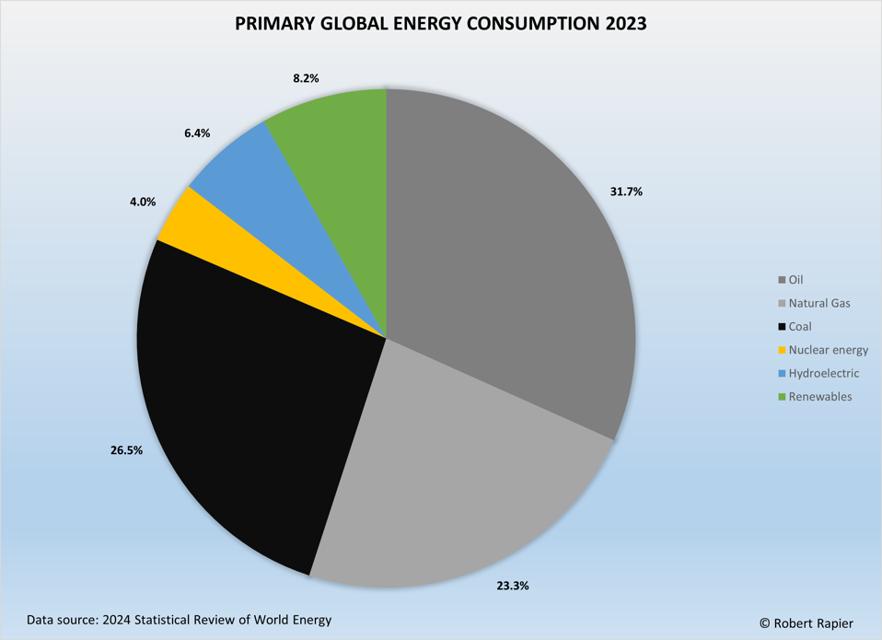
World energy scenario

Slide 4
World energy scenario
Oil (31.7%) : Oil is a liquid fossil fuel mainly used in transport (cars, trucks, ships, aviation) and petrochemical industries. It is energy-dense and easily transported but produces significant greenhouse gas and air pollutant emissions when burned.
Natural gas (23.3%): Natural gas is the cleanest-burning fossil fuel, widely used for power generation, industry, and heating. It emits less CO₂ and local pollutants than coal and oil but still contributes substantially to climate change and can leak methane during production and transport.
Coal (26.5%): Coal is a solid fossil fuel heavily used for electricity and some industrial processes such as steel and cement. It is abundant and cheap in many countries but is the most carbon-intensive and polluting major fuel, driving many policies to phase it down.

Slide 5
World energy scenario
Nuclear energy (4.0%): Nuclear power generates electricity from fission of uranium or plutonium without direct CO₂ emissions. It provides reliable baseload power but involves high capital costs, long lead times, and challenges around safety perception and long‑term radioactive waste management.​
Hydroelectric (6.4%): Hydropower converts the potential energy of stored or flowing water into electricity, offering flexible, low‑carbon generation and reservoir storage benefits. However, large dams can disrupt river ecosystems, displace communities, and are limited by geography and water availability.​
Renewables (non‑hydro, 8.2%) : This group includes wind, solar, bioenergy, and other emerging renewables that provide low‑carbon electricity and heat. Their costs have fallen rapidly, making them the fastest‑growing energy sources, though their variability requires grid flexibility, storage, and backup capacity.

